Slide 1

Advanced features
Learn how to build AI on Sui and interact with smart contracts, simple onboard experience with ZK login and Sponsored Transaction

Slide 2
Agenda
How zkLogin Works
Sponsored Transactions - Gas Fee Management
Sui Oracles - Bringing Off-Chain Data On-Chain
Cross-Chain Bridges on Sui
Building Autonomous AI Agents on Sui
Practical Exercises

Slide 3
How zkLogin Works
Log into Sui dApps with familiar web credentials and privacy via zero-knowledge proofs.
User Login
Privacy Preservation
Proof Generation
Authenticate with Google or Facebook credentials
Verify identity without revealing personal data
Create zkProofs using JWT and salt for account security
https://docs.sui.io/concepts/cryptography/zklogin

Slide 4
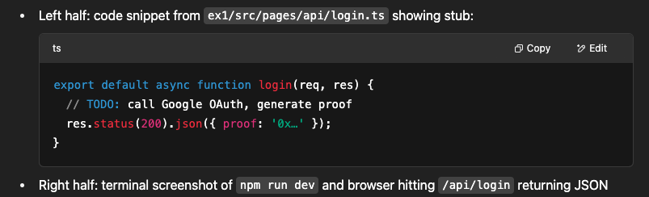
Exercise — zkLogin Integration
Your task: complete the login.ts handler. Use @googleapis/oauth2 to authenticate and @sui/sui.js’s generateZkProof helper.
Example: https://docs.sui.io/guides/developer/cryptography/zklogin-integration/zklogin-example

Slide 5

Sponsored Transactions - Gas Fee Management
Gas Sponsorship Roles
Service Example
Use Case
User, Gas Station, Sponsor manage fees seamlessly
Shinami's Gas Station simplifies sponsoring gas payments
Gaming dApps sponsor early transactions to boost users
(https://blog.sui.io/shinami-gas-station-tutorial/)

Slide 6
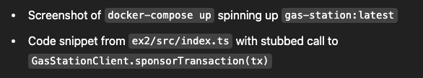
Exercise — Sponsor Your First Tx

Slide 7
Sui Oracles - Bringing Off-Chain Data On-Chain
Available Oracles
Developers Tools
Chainlink
Band protocol
Mysten Labs’ simple and meta oracles
Guides for building oracles with Sui’s high throughput
https://docs.sui.io/guides/developer/app-examples/weather-oracle#initialize-the-project
https://github.com/pentagonxyz/move-oracles

Slide 8
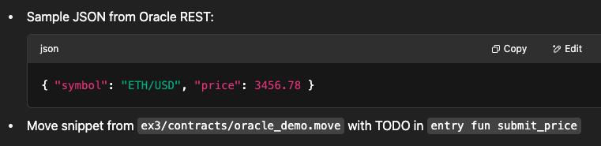
Exercise — On‑Chain Price Feed
Requirements: make post APi http://localhost:8080/price?symbol=ETH/USD, parse the JSON in your Node script, then call your Move oracle contract’s submit_price function

Slide 9
Cross-Chain Bridges on Sui - interoperability
Sui Bridge (Native Bridge)
Supported Assets: ETH, WETH, USDT, WBTC, LBTC
Mechanism: Lock-and-mint model
https://bridge.sui.io/
Other bridge
https://wormhole.com/docs/tutorials/messaging/sui-connect/
Circle's CCTP (for USDC)

Slide 10
Building with AI Agents on Sui
Agent Logic
Oracles & Automation
External AI Models
Security
Defined in Move smart contracts for on-chain actions
Connect data feeds; sponsor transactions for automation
Integrate off-chain AI for decision-making
Use Move capabilities and access controls

Slide 11
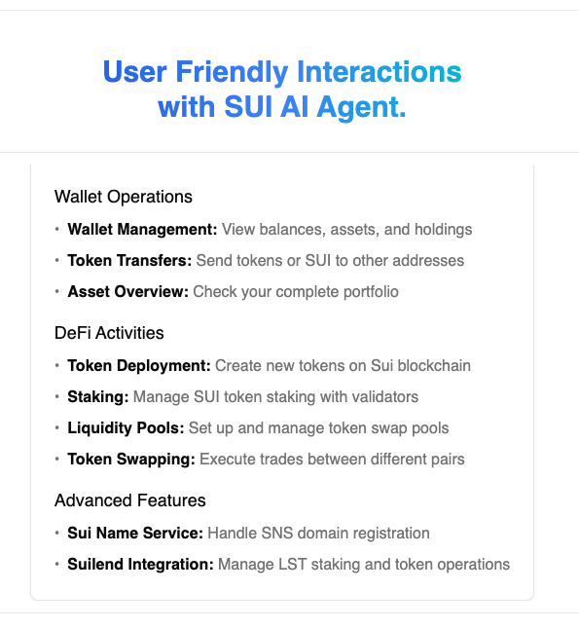
AI Agent Use Case: Nimbus AI Agent Kit
This kit support to build AI agent on Sui
Support to get wallet balance
Support to interact with multiple Sui defi protocol
https://agent.getnimbus.io/

Slide 12
Practical Exercises
Building Simple AI Agent to track wallet balance
Sample AI agent KIT: https://docs.getnimbus.io/sui-ai-agent/introduction
SDK: https://www.npmjs.com/package/@flowx-finance/sdk

Slide 13
Thank You.

